Slide 1
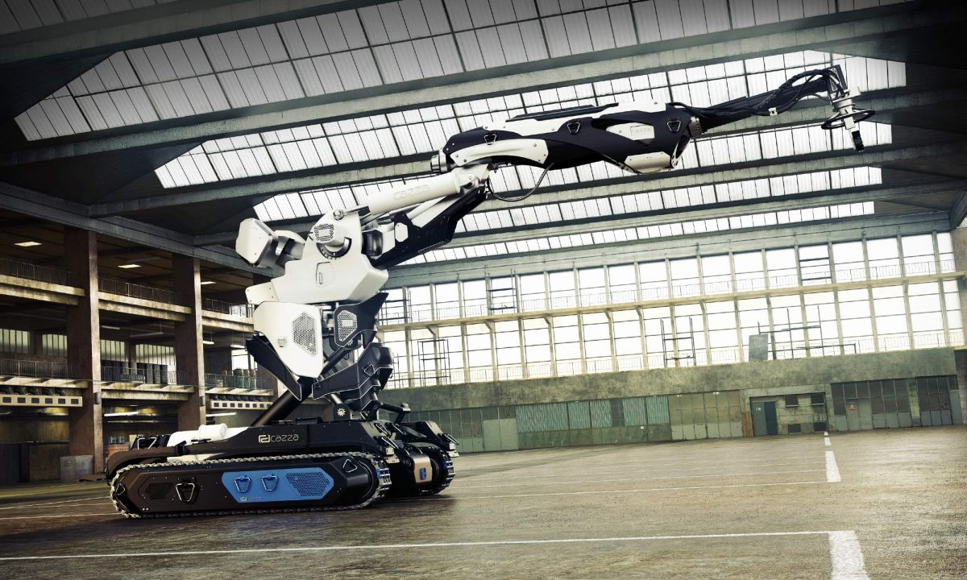
CAZZAX1-based model Inverse kinematics
Simone Vollaro

Slide 2

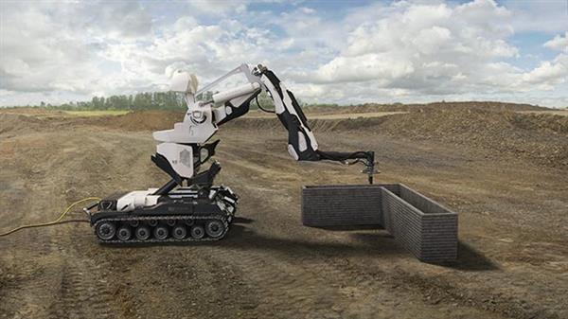
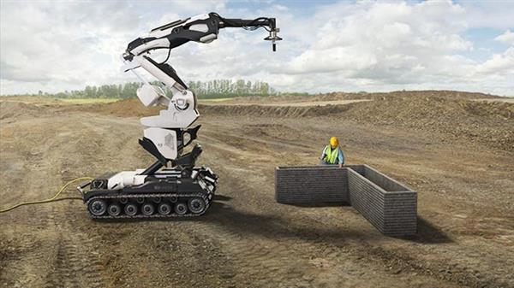
Project overview
First founded in 2016, the Finland-based company Cazza devised a concept for an industrial 3D printer using concrete to construct buildings up to two floors high.
After receiving attention and funds from a variety of backers thanks to their promises in terms of printing speed and material consumption, one of the cofounders stole all of the company budget and disappeared.
Since there is not even a prototype of the machine, nor prototyping documentation, the following is a model simulation based on the visual concepts and available information of the 3D printing arm: the Cazza X1.
Notes:
100mm per second
19-year-old Chris Kelsey
Drone: Obliterate, 3D Print, Lift & Place

Slide 3
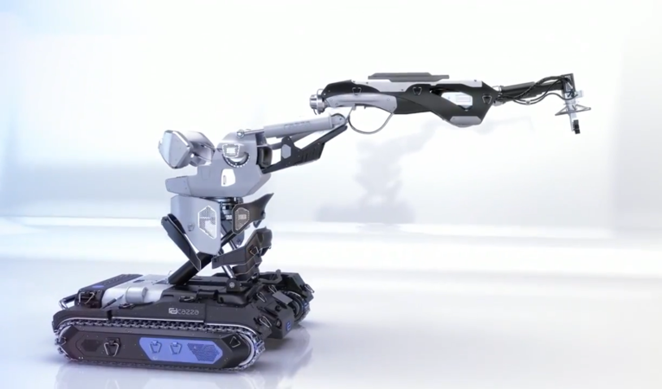
Arm concept
For this redundant manipulator we designed a model having 12 joints:
4 prismatic joints
8 rotoidals joints

Slide 4
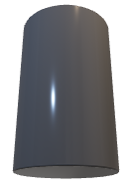

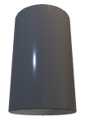


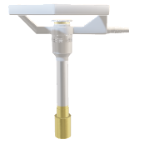



Model design
J10 - J11 – J12
J8
L8
J9
L10 - L11
J7
L9
L12
L7
L6
EE
J6
L5
J5
L4
J4
L3
Joints J1, J2, J3 are considered being of the same part of the robot: the moving base.
Similarly, joints J10, J11, J12 are all part of the spherical wrist.
J1
L1
J3
J2
L2

Slide 5
Reference systems
x₈
d9
z₈
x₁₁
x₉
z₁₀
y₁₀
z₁₁
θ12
y₆
y₈
y₇
y₉
θ11
y₅
θ10
z₉
x₁₀
y₁₁
x₅
x₆
θ8
x₇
z₁₂
θ6
θ7
z₇
z₄
y₄
z₆
z₅
y₁₂
x₁₂
θ5
x₄
x₃
z₃
y₃
d4
d2
z₂
y₂
y₀
x₀
x₁
z₁
z₀
y₁
θ3
x₂
0₅ ≡ 0₄
0₇ ≡ 0₈
0₉ ≡ 0₁₀ ≡ 0₁₁
d1

Slide 6
Denavit - Hartenberg
Ref. systems | Link | a | α | d | θ
{S0} → {S1} | L0 | 0 | π/2 | d1 | π/2
{S1} → {S2} | L1 | 0 | π/2 | d2 | π/2
{S2} → {S3} | L2 | 0 | 0 | d3 | π/2 + θ3
{S3} → {S4} | L3 | 0 | 0 | d4 | -π/2
{S4} → {S5} | L4 | 0 | π/2 | 0 | θ5
{S5} → {S6} | L5 | a6 | 0 | 0 | θ6
{S6} → {S7} | L6 | a7 | 0 | 0 | θ7
{S7} → {S8} | L7 | 0 | π/2 | 0 | π/2 + θ8
{S8} → {S9} | L8 | 0 | -π/2 | d9 | 0
{S9} → {S10} | L9 | 0 | -π/2 | 0 | -π/2 + θ10
{S10} → {S11} | L10 | 0 | -π/2 | 0 | π/2 + θ11
{S11} → {S12} | L11 | a12 | 0 | 0 | π/2 + θ12

Slide 7
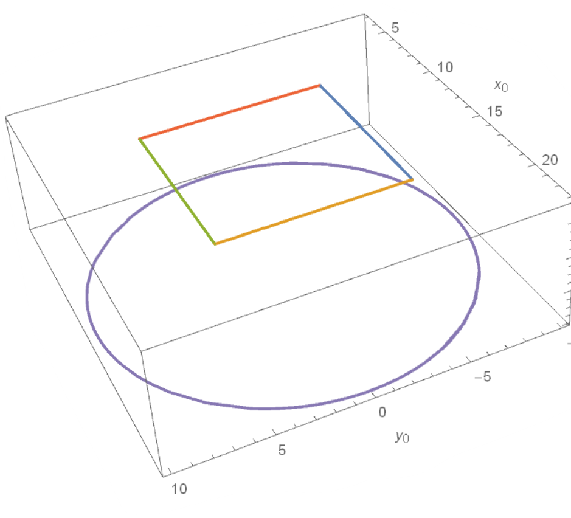
Tasks description
As a main task, the end-effector has to move along a square trajectory, resembling the four walls of a simple kind of building.
Additionally, the base of the manipulator has to move around the building on a circular path.
For both the tasks, we devised a constant reference system on which the manipulator would have to orientate itself
Desired tasks can be accustomed to target kind of building and subdivided in more steps as needed.

Slide 8
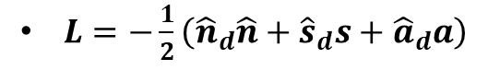
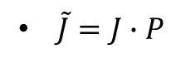
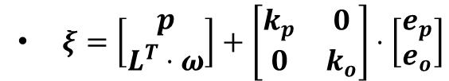
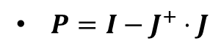
CLIK algorithm with task priority strategy
$$\dot{q}={\left\{\left[\begin{matrix}I & 0 \\ 0 & L\end{matrix}\right]⋅J_{e}\right\}}^{+}⋅ξ_{e}+P_{e}⋅{\left\{\left[\begin{matrix}I & 0 \\ 0 & L_{2}\end{matrix}\right]⋅{\tilde{J}}_{2}\right\}}^{+}⋅ξ_{2}+P_{e}∙{\tilde{P}}_{2}∙{\dot{q}}_{0}$$
where
$L=−\frac{1}{2}\left({\hat{n}}_{d}\hat{n}+{\hat{s}}_{d}s+{\hat{a}}_{d}a\right)$
matrix needed to use the geometrical Jacobina instead of the analytical Jacobian; n_{d} , n, s_{d} , s, a_{d} , a are respectively the normal, sliding, approach versors of the desired trajectory and the actual orientation.
$ξ=\left[\begin{matrix}p \\ L^{T}⋅ω\end{matrix}\right]+\left[\begin{matrix}k_{p} & 0 \\ 0 & k_{o}\end{matrix}\right]⋅\left[\begin{matrix}e_{p} \\ e_{o}\end{matrix}\right]$
twist of the desired part of the robot, comprising of the correction due to the position and orientation error
$P=I−J^{+}⋅J$
projector in the nullspace of the Jacobian matrix
$\tilde{J}=J∙P$
modification of the Jacobian for the second task, due to the task priority approach
subscripts “e” and “2” refers respectively to the first task (end effector positioning) and second task (robot base movements)

Slide 9
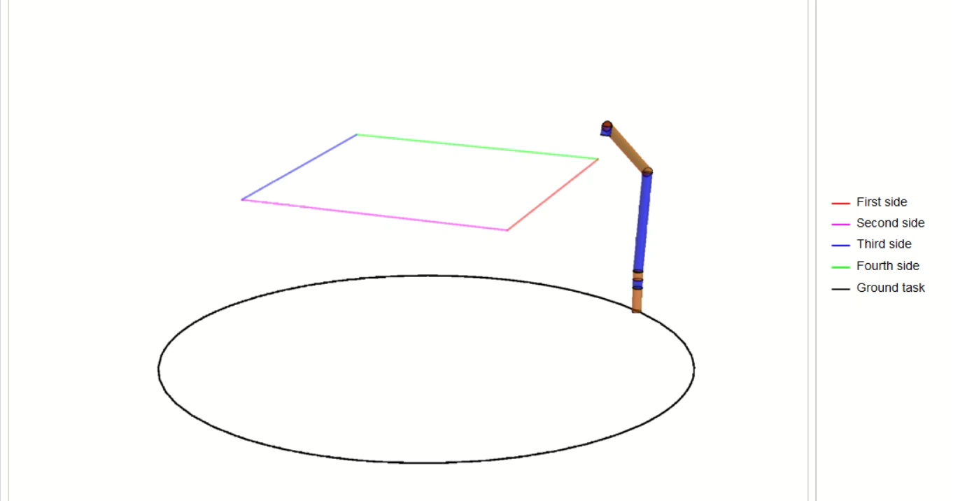
Resulting simulation

Slide 10
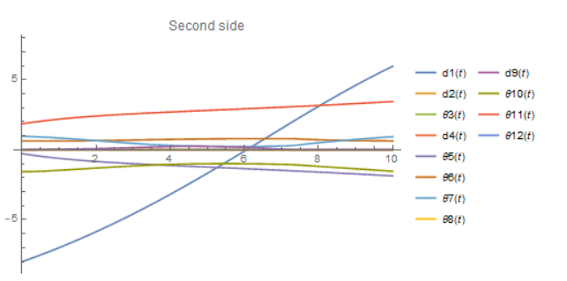
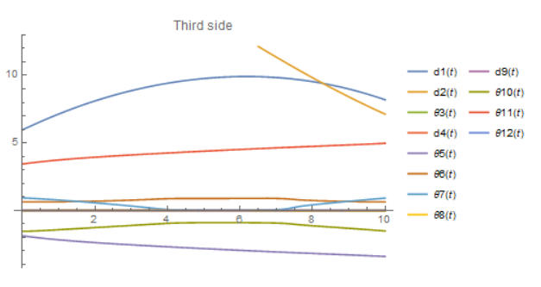
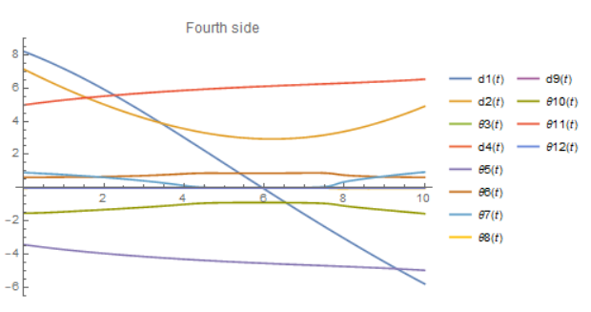
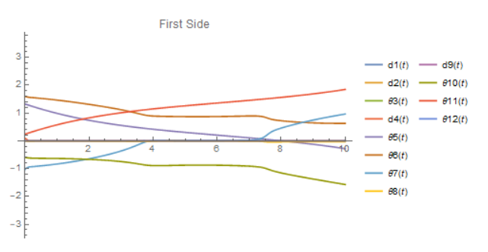
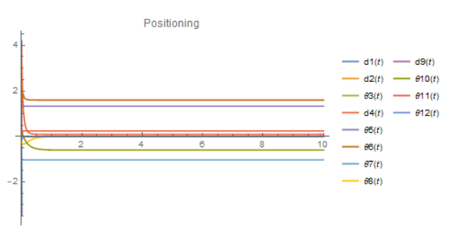
RESULTING CONFIGURATION VARIABLES

Slide 11
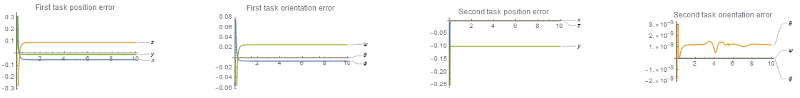
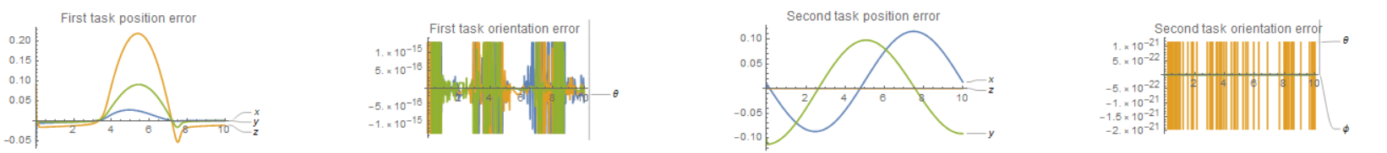
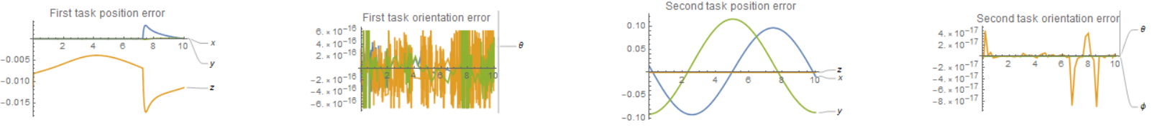
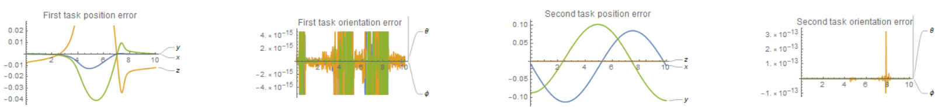
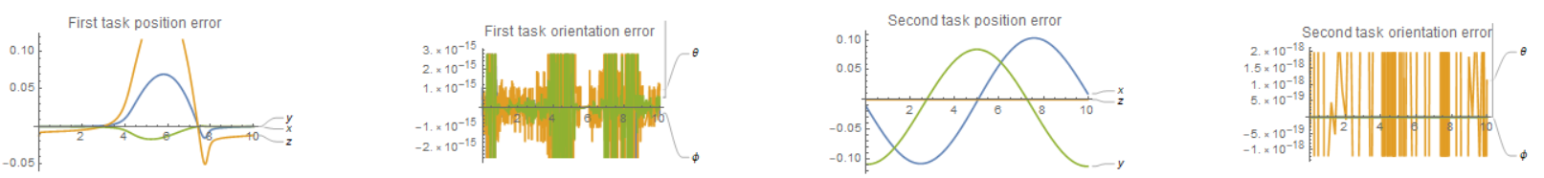
POSITION AND ORIENTATION ERRORS
PTP
Side1
Side2
Side3
Side4

Slide 12
References
The overall project makes extensive use of content based on the following:
Lecture notes from Marco Gabiccini’s Master Course in Robot Mechanics (Robotics and Automation Engineering master degree)
B. Siciliano, L. Sciavicco, L. Villani, G. Oriolo, “Robotics: Modelling, Planning and Control"
Stefano Chiaverini, “Singularity-Robust Task-Priority Redundancy Resolution for Real-Time Kinematic Control of Robot Manipulators”
Pasquale Chiaccio, Bruno Siciliano, “Closed-Loop Inverse Kinematics Schemes for Constrained Redundant Manipulators with Task Space Augmentation and Task Priority Strategy”
Ashish Singla, Prasad Kulkarniy, Sandeep Kumary, Bhaskar Dasgupta , “Redundancy Control of Robot Manipulators using Task Priority”
Images taken from:
fabbloo.com
Fanatical Futurist Youtube channel
3ders.org (website now expired)

